Slide 1

HS3052 Capstone Project Design: Supplementary Document
Supervisor: Dr. Farshid Keivanian
Session 4: Preparation for Group Assignment 4 (Solution Prototype)

Slide 2
Session 4’s Outline
Weekly Task Breakdown & Milestones
Preparation for Group Assignment 4 – Solution Prototype
Group Progress Presentation – Overview of Progress at least 2 min
Final Note

Slide 3
Weekly Task Breakdown & Milestones
Week | Tasks | Notes
1 | Finalise group & select topic | Choose from topics like Library Mgmt, Lost & Found, Feedback System, etc.
2 | Project Management Package (Assessment 1 due) | Scope, charter, WBS, Gantt chart – submit as a group
3–4 | Requirements analysis + Literature review | Collect references, interview users, gather data, start drafting RS
5 | Presentation of proposed solution (Assessment 2) | Slides + demo/mockup preview
6 | Submit Requirements Specification (Assessment 3) | System overview, diagrams, user stories, use cases, ERD, schema
7 | Prototype building begins | Setup tools, split coding and UI/UX tasks among group

Slide 4
Weekly Task Breakdown & Milestones
Week | Tasks | Notes
8–11 | Development + testing | Complete features, peer review, fix bugs, update documents
12 | Submit Final Prototype + Docs (Assessment 4) | Include testing report, user manual, installation guide, project closure plan

Slide 5
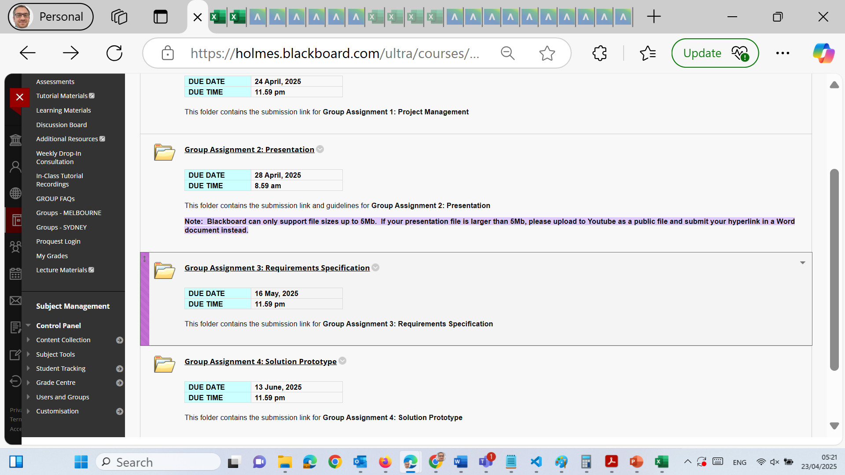
Preparation for Group Assignment 4: Solution Prototype

Slide 6
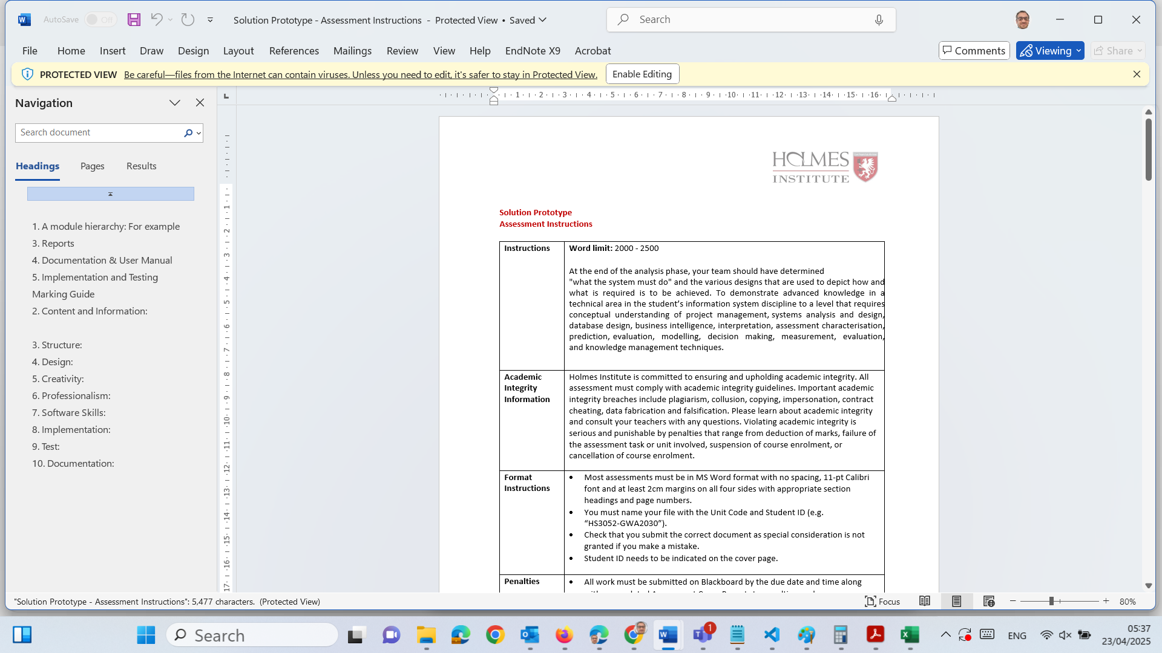
Preparation for Group Assignment 4: Solution Prototype

Slide 7
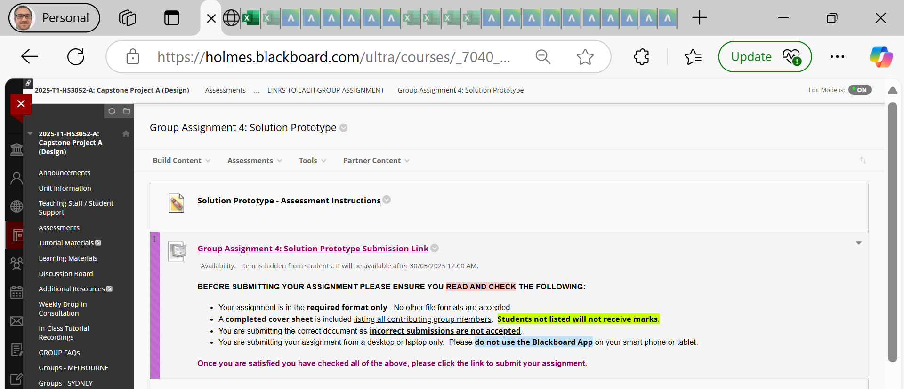
Preparation for Group Assignment 4: Solution Prototype

Slide 8
Preparation for Group Assignment 4: Solution Prototype
Word Limit: 2000–2500 words Weight: 30%

Slide 9
Preparation for Group Assignment 4: Solution Prototype
Purpose of the Assignment:
This assignment allows your team to present a working prototype of your proposed system. You will showcase the design, functionality, and implementation strategy, demonstrating practical application of your technical and analytical skills.
Your submission should demonstrate:
Technical competency in building and designing software interfaces.
Clear understanding of the requirements outlined in Assignment 3.
Thoughtful system architecture, functionality, usability, and real-world viability

Slide 10
Preparation for Group Assignment 4: Solution Prototype
Required Components
1. Module Hierarchy (3%)
Display a diagram showing the system’s structure.
Use a tree or chart format (e.g., Admin > User Management > Add User, Edit User, etc.).
Clearly define modules, submodules, and their interactions.

Slide 11
Preparation for Group Assignment 4: Solution Prototype
2. Mock-up Screens (5%)
Include annotated mock-ups of important system interfaces.
Screens should show layout, font, color, and button placement.
Tools: You can use Figma, Adobe XD, Balsamiq, or simply annotated PowerPoint slides.
Tip: Group similar interfaces together and explain reusable design elements.

Slide 12
Preparation for Group Assignment 4: Solution Prototype
3. Reports (6%)
Define what business reports your system can generate (e.g., User Activity Report, Monthly Sales Summary).
Provide sample report layouts: show headings, data tables, filters, and formats.

Slide 13
Preparation for Group Assignment 4: Solution Prototype
4. Documentation & User Manual (6%)
Your documentation should be usable and informative for new users:
Interface text: Instructions, menus, tooltips, error messages.
Operational messages: Error handling and warnings.
Online help: FAQs, tutorials, navigation tips.
Printable User Manual: Describe steps for login, task execution, troubleshooting.
Hint: Include screenshots with annotated steps to guide usage.

Slide 14
Preparation for Group Assignment 4: Solution Prototype
5. Implementation & Testing (10%)
Explain how your system is built: which tools, technologies, and how modules are connected.
Include:
Screenshots of your working prototype.
Technology stack used (e.g., XAMPP + PHP + MySQL + HTML/CSS/JS).
Brief database structure.
Testing strategy: Describe unit, integration, and user testing conducted. Mention test results and any known bugs/fixes.

Slide 15
Preparation for Group Assignment 4: Solution Prototype
Tips for Success
What To Do:
Organize content logically: Introduction → Design → Implementation → Testing.
Use diagrams for clarity (Gantt chart, mockups, architecture, etc.).
Clearly label and caption all images and diagrams.
Write in clear professional language suitable for a business and technical audience.
Follow formatting guidelines: Calibri 11pt, 2cm margins, appropriate headings.

Slide 16
Preparation for Group Assignment 4: Solution Prototype
❌ What to Avoid:
Submitting screenshots with no explanation.
Omitting your group number or student names from the cover sheet.
Using technical jargon without context.
Missing citation of tools, libraries, or borrowed resources.

Slide 17
Preparation for Group Assignment 4: Solution Prototype
Submission Requirements
Format: MS Word (.docx)
Filename: HS3052-StudentID.docx
Include: Assessment Cover Page with all group members listed
Submit via Blackboard by (refer to blackboard for the due date)

Slide 18
Preparation for Group Assignment 4: Solution Prototype
Marking Guide (30% Total)
Criteria | Weight
Module Hierarchy | 3%
Mock-up Screens | 5%
Reports | 6%
Documentation & User Manual | 6%
Implementation & Testing | 10%

Slide 19
Preparation for Group Assignment 4: Solution Prototype
Suggested Tools
Design/Mockups: Figma, Balsamiq, Adobe XD, PowerPoint
Development: XAMPP, PHP, MySQL, HTML, CSS, JS
Reporting: Excel, Power BI, Google Data Studio
Documentation: MS Word, Google Docs

Slide 20
Preparation for Group Assignment 4: Solution Prototype
Academic Integrity Reminder
Strict penalties apply for:
Plagiarism
Contract cheating
Collusion
Submission impersonation
Always produce original work and credit all sources using Holmes Adapted Harvard Referencing.

Slide 21
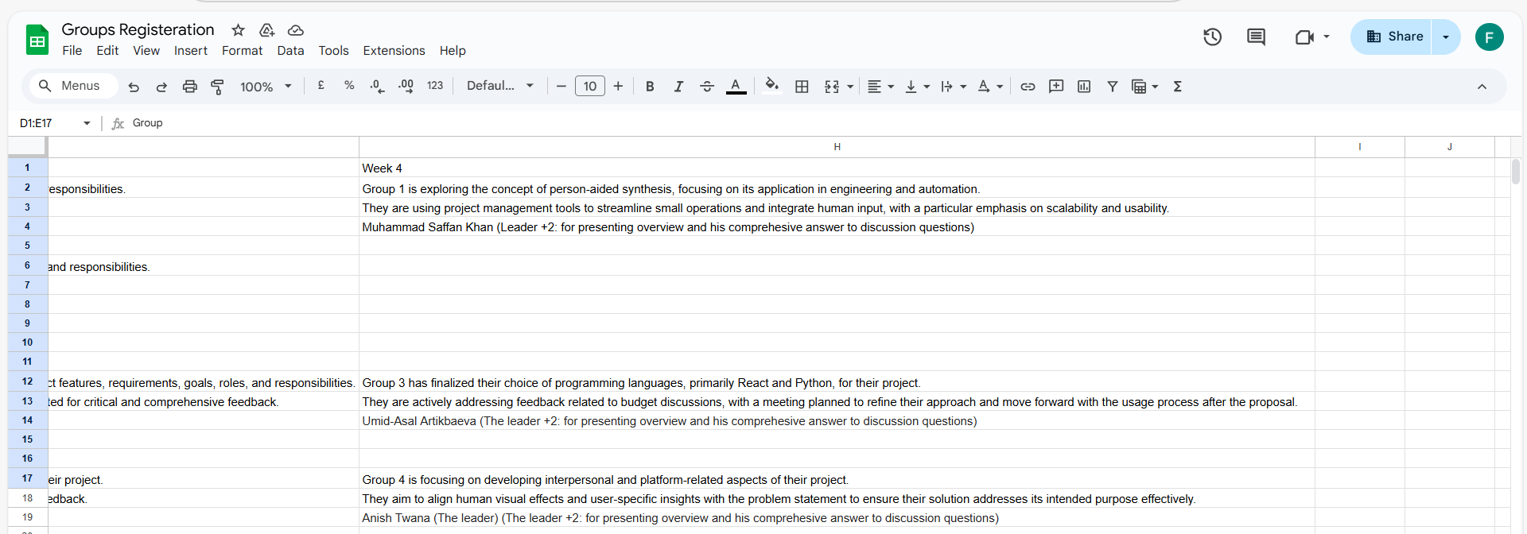
Group Progress Presentation – Overview of Progress at least 2 min

Slide 22
Question and Answers
Q1. Do students need to develop a prototype (website, mobile app, or software)?
Yes — students are required to develop a functional prototype of a system, such as:
A website or web app
A mobile app
A software application
A database-driven system (e.g. Power BI, Tableau dashboard)
The prototype must include:
Mock-up screens
Reports generated from a database
Documentation
Implementation and Testing
Screenshots and examples of how it works
This all implies a working system or a demonstrable partial product — not just research or a concept.

Slide 23
Question and Answers
Q2. Is this purely software/mobile development or both research + development?
It is primarily a development task with research embedded into:
Analysis
Design methodology
Database structure
User needs
Testing and evaluation
So while some research is expected, the main deliverable is a working prototype, not a purely research paper.

Slide 24
Question and Answers
Q3. What kind of prototype is acceptable?
The instructions are flexible about the form of the prototype. Examples include:
A website (HTML/CSS/JS or a low-code tool)
A mobile app (even using a prototype tool like Figma, Flutter, or Thunkable)
A desktop or cloud-based system using tools like Power BI, MS Access, or Python
A mock-up or wireframe prototype (if it's high-fidelity with detailed functionality explained)
Note: If your team is short on time or development skills, a mock-up with screenshots and a clearly designed system flow might be accepted — but it should be detailed enough to show realistic functionality.

Slide 25
Question and Answers
Final Clarification
There is no mention that you must choose between research or development. Instead, you’re expected to apply research methods as part of the development of a working solution prototype — this is a design and implementation-heavy assessment.

Slide 26
Question and Answers
Beginner Friendly tools
You can use these tools to develop your solution prototype — whether it's a website, mobile app, or a system interface. These tools require little to no coding and are ideal for students working under time constraints.

Slide 27
Question and Answers
1. For a Website/Web App
Google Sites (No coding)
Best for: Simple system mockups, dashboards, portals
Features: Drag-and-drop, embed Google Forms, Docs, Sheets
Link: https://sites.google.com
Ideal if: You want to build a simple interface + embed sample reports (e.g., PDFs, charts)

Slide 28
Question and Answers
Wix / Webflow / Carrd
Best for: Highly visual web apps or landing pages
Drag-and-drop editors with professional templates
Link: https://www.wix.com, https://webflow.com, https://carrd.co

Slide 29
Question and Answers
2. For Mobile App Prototypes
Figma + Figma Mobile App Mirror (Free and very popular)
Best for: Clickable mock-up of a mobile app
Features: Design screens, set user flow, present interactive demo
Link: https://www.figma.com

Slide 30
Question and Answers
Thunkable (No code mobile app builder)
Build: Native mobile apps (iOS/Android)
Drag-and-drop interface components
Link: https://thunkable.com
Bonus: You can export a working APK/app or share a preview link

Slide 31
Question and Answers
3. For Dashboards/Database Systems
Microsoft Power BI / Excel + Pivot Tables
For: Creating system-generated reports
Example: Sales report, employee performance dashboard
Good for: Showing the "Reports" component of your system

Slide 32
Question and Answers
Airtable
Hybrid of spreadsheet + database + forms
Great for creating interactive systems like task trackers or HR databases
Link: https://airtable.com

Slide 33
Question and Answers
Recommendation Based on Simplicity
Goal | Recommended Tool
Build a simple system website | Google Sites
Make a mobile app mock-up | Figma or Thunkable
Show database functionality/reports | Power BI or Airtable
Create screen flows quickly | Figma or Canva (UX templates)

Slide 34
Example) To-Do List System — Prototype Plan
A To-Do List system is a classic and practical project that works very well for this type of prototype assignment — it's simple enough to build yet rich enough to demonstrate systems analysis, interface design, database use, and testing.
To-Do List System — Prototype Plan
Key Features You Can Include:
Component | Example
Add Task | Input field for task title, due date, priority
Update Task | Edit name, deadline, or mark as complete
Delete Task | Remove task from list
Categorize | By project, subject, or tag
Reports | Completed tasks, overdue tasks, upcoming tasks
User Accounts (optional) | Multi-user support if you want to expand

Slide 35
Example) To-Do List System — Prototype Plan
Tool Suggestions Based on Approach
Option A: Simple Website — Google Sites
Design screens like:
Homepage with task list
"Add Task" form
Sample report (using embedded Google Sheet)
Link between pages like "clickable prototype"
Can embed forms, charts, mock-up screens
Good for showing screen flow + reports without coding.

Slide 36
Example) To-Do List System — Prototype Plan
Option B: Mobile App — Thunkable
Drag-and-drop blocks to build:
Home screen: list of tasks
Add Task screen: input fields
Reports screen: show task stats
You can test live on your phone or generate a preview/shareable link
Excellent if you want a working mobile prototype without code.

Slide 37
Example) To-Do List System — Prototype Plan
Option C: Mock-up — Figma
Design:
App-like interface with clickable interactions
UI screens: Home, Add Task, Edit Task, Reports
Show navigation between screens
Ideal for beautiful, clickable screen mock-ups; no coding required.

Slide 38
Example) To-Do List System — Prototype Plan
Option D: Database System — Airtable or Excel/Power BI
Use Airtable or Excel to:
Store task data
Create dashboards showing overdue tasks, completion rate
Add mock reports for the “Reports” section in your submission
Perfect for demonstrating database structure + system reporting.

Slide 39
Example) To-Do List System — Prototype Plan
Prototype Elements to Include in Your Report
Section | What to Include
Module Hierarchy | Task Manager → Add Task, View Task, Delete Task, Reports
Mock-up Screens | Screens for Add Task, Edit Task, View Tasks, Reports
Reports | Charts: % of tasks done, upcoming tasks, etc.
Documentation | How the system works, how users interact with it
Implementation & Testing | Show screenshots, note bugs/fixes, describe how you tested it

Slide 40
Example) To-Do List System — Prototype Plan
Assessment Requirements vs. To-Do List Project Deliverables
Assessment Section | How Your To-Do List Project Covers It
1. Module Hierarchy | Define modules like: User Interface → Task Manager → Add Task, Edit Task, Delete Task, View Reports.
2. Mock-up Screens | Design using Figma, Google Sites, or Thunkable to create UI for each screen (Add Task, View Task, Reports).
3. Reports | Create mock reports using Excel, Power BI, or Airtable — e.g., Completed Tasks %, Overdue Tasks, Tasks per Category.
4. Documentation & User Manual | Write a section explaining how users interact with the system, including error messages, help info, and printed/manual options.
5. Implementation & Testing | Describe tools used, testing steps (e.g., added 5 tasks, deleted 1, marked 2 completed), and any bugs or improvements.

Slide 41
Example) To-Do List System — Prototype Plan
Other Marking Criteria Mapped to Your Project
Marking Criteria | How Your To-Do List Project Can Meet It
Design & Creativity | Well-designed screens (e.g. in Figma or Thunkable) with clean layout, smart use of fonts, colors, and flow.
Professionalism | Present the system as if it's ready for a startup or productivity app — make it user-friendly, modern, and usable.
Software Skills | Use of tools like Figma, Power BI, Thunkable, or Airtable shows understanding of interface design, databases, and system logic.
Testing | Include details about what worked, what failed, and what fixes or redesigns were made during your testing process.
Documentation | Add author notes, explanations, and a user manual with screenshots — this is key for full marks.

Slide 42
Final Note
The instruction of the Solution Prototype on the Blackboard is the formal and assessable requirement as outlined in the unit guide and rubric. The expectation is that your team demonstrates a complete understanding of system design and development principles through deliverables such as:
Module hierarchy
Mock-up screens
Report designs
Documentation and user manual
Implementation and testing process (including screenshots and description of your system's features)

Slide 43
Final Note
While mock-up screens created in Figma are acceptable as part of the design phase, they cannot replace the implementation and testing section, which carries significant weight (10%). Therefore, a coded prototype (functional or semi-functional) is required as part of your final submission, particularly because your project is a web-based application (or mobile-based or software-based application).
The GitHub materials are intended as supplementary guidance. They help you understand various pathways (e.g., Figma mockups for early design), but the assessment is based strictly on the requirements listed in the official instructions (on the blackboard).

Slide 44
Final Note
Students, you can absolutely use Figma for the design portion (mock-up screens), but your final report must also include implementation details and testing outcomes for a working or demonstrable prototype, even if it’s a simplified or partially functional version.
Please feel free to reach out if your group needs any further clarification or support as you progress.
Best regards, Dr. Farshid Keivanian

Slide 45
Thank You
Need Help? Send an email or ask during the tutorial session.
Good luck with your capstone journey!
Dr. Farshid Keivanian Capstone Project Supervisor

